Slide 1


Computech Corporation: Advanced Job and Candidate Application
Test Plan
Simul Kadakia, Wesley Trescott, Gagandeep Singh
3/23/2015

Slide 2
Contents
Functional Testing
Nonfunctional Testing
Compatibility Testing
System Testing
Integration Testing
Performance and Load Testing
Security Testing
User Acceptance Testing
Unit Testing

Slide 3
Functional Testing
Emphasizes the working of the actual application features
Test Approach
Follow procedures in test cases using interaction with UI
Test Pass/Fail Criteria
Pass: Observed results are the same as expected results
Fail: Observed results differ from expected results

Slide 4
Functional Testing
Test Entry/Exit Criteria
Entry: Test environment ready to use
Exit: All use cases are tested, all test cases pass sucessfully, defects found are documented and solutions found
Test Suspension/Resumption Criteria
Testing will be suspended as soon as a test case fails
After a solution is implemented, testing will resume
Test Cases
FT_1: Search Jobs | FT_2: Register | FT_3: Email Verification | FT_4: Login | FT_5: Forgot Password | FT_6: Change Password | FT_7: Apply
FT_8: Filter Jobs | FT_9: Profile Information | FT_10: Resume Upload | FT_11: Admin Login | FT_12: Admin Search Users | FT_13: Admin Deactivate User | FT_14: Admin Delete User

Slide 5
Functional Testing
ID | FT_2
Item to Test | Register
Pre-Conditions | None
Test Steps | Click on Users button on header. Click on Register link button. Fill in First name - John, Last name - Doe, Email ID – john.doe@email.com, Password - 123456, Confirm Password - 123456. 4. Click on Register.
Expected Results | System displays confirmation page with a message about verification email sent to user provided email address.
Priority | High
Pass/Fail | Pass if system redirects user to Register page.

Slide 6
Nonfunctional Testing
Testing application reliability and availability
Test Risks / Issues
Unanticipated problems such as long server downtimes could make the application unusable
Test Approach
Stopwatch testing of job search times (10 searches with 4 filters)
Stopwatch testing of home page load time (10 loads)
Test Pass / Fail Criteria
Pass if all tests result in load times of two seconds or less
Fail otherwise
Test Entry Criteria
Web application hosted on Computech server
Test Environment Needs
User machine with 1 GB of available RAM; internet download speeds of at least 2 MBPS

Slide 7
Nonfunctional Testing
ID | NT_1
Item to Test | Application Reliability
Pre-Conditions | The web application is hosted on the Computech server
Test Steps | Execute the following ten times: In the job search window select criteria from each filter Execute the search and start stopwatch Compare results to items selected in search window
Expected Results | Search results match criteria selected by the user logically AND together; all search results are loaded to the web page within two seconds
Priority | High
Pass/Fail

Slide 8
Compatibility Testing
Verify that the web application is completely usable on each supported device:
Device | Operating System | Browsers
Laptop / Desktop | Windows (any) OS X | Google Chrome Mozilla Firefox Safari Internet Explorer > 9
Tablets iPad Air | iOS 8.1.3 | Safari
Phone iPhone 6 Samsung Galaxy S5 | iOS 8.1.3 Android v5.0 (Lollipop) | Safari Google Chrome

Slide 9
Compatibility Testing
Test Approach
Test each item in test deliverables in the user interface
Test Pass/Fail Criteria
Pass: 100% of test cases successfully and easily completed
Fail: Any fault or excessive diffiuculty in performing a UI operation, excluding resume upload on Apple devices
Test Entry/Exit Criteria
Entry:
Devices are functioning properly and ready to use
Proper browsers are installed with up-to-date JavaScript engines
Exit:
All tests have been run successfully and no high priority bugs are left uncorrected

Slide 10
Compatibility Testing
Test Environmental Needs
Desktop/Laptop: Testing on Internet Explorer, Google Chrome, Mozilla Firefox, and Safari browsers
Samsung Galaxy S5 and iPad Air: Google Chrome emulators
iPhone 6: Testing on Gagandeep’s phone, Safari browser
Test Cases
CT_1: Search Jobs | CT_2: Register | CT_3: Email Verification | CT_4: Login | CT_5: Forgot Password | CT_6: Change Password | CT_7: Filter Jobs
CT_8: Profile Information | CT_9: Apply | CT_10: Resume Upload | CT_11: Admin Login | CT_12: Admin Search Users | CT_13: Admin Deactivate User | CT_14: Admin Delete User

Slide 11
Compatibility Testing
ID | CT_2
Item to Test | Register
Pre-Conditions | None
Test Steps | Repeat the below process for each supported Device and Browser type Click on Users dropdown list on the header. Click on Register link. Fill in First Name, Last Name, Email Address, Password and Confirm Password. Click on Register
Expected Results | System should send an email to user containing email verification link and display confirmation page to user.
Priority | High
Pass/Fail | Pass if system redirect user to Register page.

Slide 12
System Testing
Focuses on the system as a whole without isolating any components.
No unit tests will be used. The system will be tested by interacting with UI.
Test Pass / Fail Criteria
If observed results are the same as expected results and the System is still stable and functional, the test case will pass; otherwise, test case will fail.

Slide 13
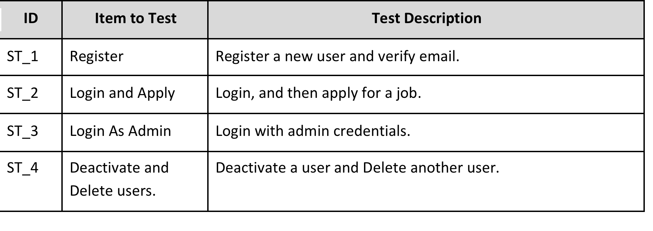
System Testing

Slide 14
Integration Testing
Not central to our testing plan, as the MVC architecture is tightly coupled and not made of large, disjointed components that need to be integrated together
Unlikely that software bugs are the result of a bug in the integration of the ASP.NET MVC framework
Test Approach
Follow functional testing test cases; in case of errors look for possible solution in system integration
Better solution: unit testing

Slide 15
Integration Testing

Slide 16
Performance & Load Testing
Testing the ability of the application fulfill its functional requirements in a reasonable time under extreme conditions
Test Approach
Conduct standard automated load test using the Microsoft Visual Studio tool designed for use with ASP.NET web applications
Test will simulate 50 simultaneous application logins
Test Pass/Fail Criteria
Pass if average load time for all simulated logins is 2 seconds or less; fail otherwise (requiring debugging)
Test Environmental Needs
Need access to source code and Visual Studio Ultimate 2013

Slide 17
Performance & Load Testing
Test Case

Slide 18
Security Testing
Test Risks/Issues
Security loopholes leading to loss of user data could make applicaton unsafe for use
Items To Be Tested
Secure user login
Admin mode
Password encryption
SSL encryption
Test Approach
Interacting with web application user interface
Accessing Geocerts SSL certificate validation site
Reviewing records in application database

Slide 19
Security Testing
Test Item | Test Approach
Secure User Login | Web Applicaton UI
Admin Mode
SSL Encryption | Geocerts.com SSL verification
Password Encryption | Review DB records
Test Pass/Fail Criteria
Pass when each test case passes; fail otherwise
Test Suspension/Resumption criteria
Due to high importance of security, suspend testing when a security violation is detected until the issue is resolved

Slide 20
Security Testing
ID | ST_1.1
Item to Test | Secure User Login
Pre-Conditions | All other functional and nonfunctional application testing is complete
Test Steps | Click on Login. Enter random email and password credentials.
Expected Results | A message must be shown that invalid user login credentials were entered.
Priority | High
Pass/Fail

Slide 21
User Acceptance Testing
Last step in testing; done by members of Computech quality assurance team
Test Approach
Test cases below are completed through interaction with UI
Test Pass/Fail Criteria
Pass if 100% of test cases completed satisfactorily; fail otherwise
Test Entry/Exit Criteria
Entry Criteria: All other testing is complete
Exit Criteria: All tests run sucessfully
Test Cases
UT_1: Search Jobs | UT_2: Register | UT_3: Email Verification | UT_4: Login | UT_5: Forgot Password | UT_6: Change Password | UT_7: Apply
UT_8: Filter Jobs | UT_9: Profile Information | UT_10: Resume Upload | UT_11: Admin Login | UT_12: Admin Search Users | UT_13: Admin Deactivate User | UT_14: Admin Delete User

Slide 22
Unit Testing
Programmatically test methods and classes from source code
Items To Be Tested
ID | Item to Test | Test Description
UT_1 (_) | Register | Call User.Register() to create user account
UT_2 (_) | Email verification | Call User.Confirmed() to verify user email.
UT_3 (_) | Login | Call LoginUser.IsValid() to verify credentials.
UT_4 (_) | Forgot Password | Call EmailManager.SendForgotPasswordEmail() to send an email to user.
UT_5 (_) | Change Password | Call ChangePassword.UpdatePassword() to update password in database.
UT_6 (_) | Apply | Call Apply.SubmitApplication() to apply to a job.
UT_7 (_) | Job Details | Call Details() in JobSearchController to display details of a job.
UT_8 (_) | Filter Jobs | Call Index() in JobSearchController to filter jobs based on parameters.
UT_9 (_) | Admin – Login | Call IsAdminValid() to verify admin credentials.

Slide 23
Unit Testing
Test Approach
Test each method in all of the model classes
Logic methods in Controller classes will also be tested
Test Pass/Fail Criteria
Use Assert classes to verify the returned values. Pass if assert passes; otherwise fail.
Test Entry/Exit Criteria
Entry Criteria: test environment ready, test stubs completed
Exit Criteria: all modules tested and passed
Test Suspension/Resumption Criteria
Testing will be suspended when a bug is found and resumed when the error is corrected
Test Environmental Needs
Requires Microsoft’s NUnit unit testing environment

Slide 24
Unit Testing
ID | UT_1.3
Item to Test | Register Fails
Pre-Conditions | Account already created with email “john.doe@email.com”
Test Steps | Call User.Register(firstName, lastName, email, password, guid) { firstName = “John”, lastName = “Doe”, email = john.doe@email.com, password = “123456”, GUID = “a6d7f3b6-c65d-4319-89d9-e5b518720e39” } and store returned value in Boolean variable. 2. Verify returned value with expected value.
Expected Results | False should be returned
Priority | High
Pass/Fail | Pass if IsAssert(false) is true

